Slide 1
The Ramachandran Plot
Mrs. APARNA PATIL KOSE
DEPT OF BIOINFORMATICS

Slide 2
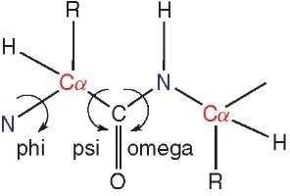
The Ramachandran Plot
The two torsion angles of the polypeptide chain, describe the rotations of the polypeptide backbone around the bonds between N-Cα (called Phi, φ) and Cα-C (called Psi, ψ)
It provides an easy way to view the distribution of torsion angles of a protein structure

Slide 3
The Ramachandran Plot
It also provides an overview of allowed and disallowed regions of torsion angle values
– serve as an important indicator of the quality of protein three-dimensional structures
Torsion angles are among the most important local structural parameters that control protein folding
Third possible torsion angle within the protein backbone (called omega, ω)

Slide 4
The Ramachandran Plot
if we would have a way to predict the Ramachandran angles for a particular protein, we would be able to predict its 3D folding
The reason is that these angles provide the flexibility required for the polypeptide backbone to adopt a certain fold, since ω is essentially flat and fixed to 180 degrees
This is due to the partial double-bond character of the peptide bond, which
restricts rotation around the C-N bond, placing two successive alpha-carbons and C, O, N and H between them in one plane
Thus, rotation of the protein chain can be described as rotation of the peptide bond planes relative to each other

Slide 5
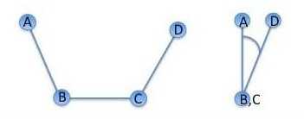
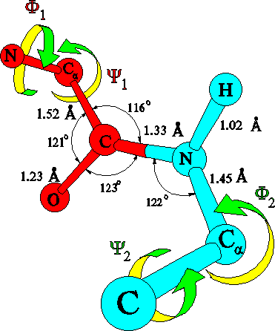
Torsion angles
Torsion angles are dihedral angles, which are defined by 4 points in space
In proteins the two torsion angles phi and psi describe the rotation of the polypeptide chain around the two bonds on both sides of the C alpha atom

Slide 6
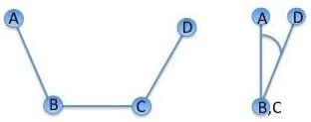
Dihedral angle
The standard IUPAC definition of a dihedral angle is illustrated in the figure below
A, B, C and D illustrate the position of the 4 atoms used to define the dihedral angle
The rotation takes place around the central B-C bond
The view on the right is along the B-C bond with atom A placed at 12 o'clock
The rotation around the B-C bond is described by the A-B-D angle shown of the right figure: Positive angles correspond to clockwise rotation

Slide 7
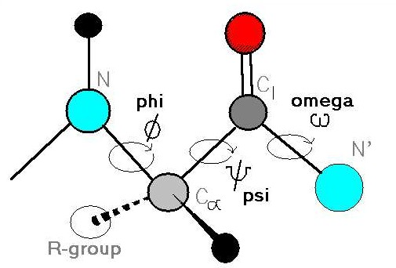
Protein backbone
The protein backbone can be described in terms of the phi, psi and omega torsion angles of the bonds:
The phi angle is the angle around the -N-CA- bond (where 'CA' is the alpha-carbon)
The psi angle is the angle around the -CA-C- bond
The omega angle is the angle around the -C-N- bond (i.e. the peptide bond)

Slide 8
The Ramachandran Plot
In a polypeptide the main chain N-Calpha and Calpha-C bonds relatively are free to rotate. These rotations are represented by the torsion angles phi and psi, respectively
G N Ramachandran used computer models of small polypeptides to systematically vary phi and psi with the objective of finding stable conformations
For each conformation, the structure was examined for close
contacts between atoms
Atoms were treated as hard spheres with dimensions corresponding to their van der Waals radii
Therefore, phi and psi angles which cause spheres to collide correspond to sterically disallowed conformations of the polypeptide backbone

Slide 9
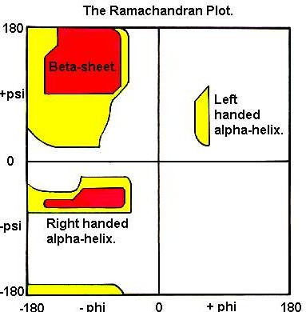
The Ramachandran Plot
In the diagram the white areas correspond to conformations where atoms in the polypeptide come closer than the sum of their van der Waals radi
These regions are sterically disallowed for all amino acids except glycine which is unique in that it lacks a side chain

Slide 10
The Ramachandran Plot
The red regions correspond to conformations where there are no steric clashes, ie these are the allowed regions namely the alpha-helical and beta-sheet conformations
The yellow areas show the allowed regions if slightly shorter van der Waals radi are used in the calculation, ie the atoms are allowed to come a little closer together
This brings out an additional region which corresponds to the left-handed alpha-helix

Slide 11
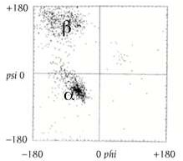
Ramachandran plot

Slide 12
The Ramachandran Plot
L-amino acids cannot form extended regions of left- handed helix
but occassionally individual residues adopt this conformation
These residues are usually glycine but can also be asparagine or aspartate where the side chain forms a hydrogen bond with the main chain and therefore stabilises this otherwise unfavourable conformation
The 3(10) helix occurs close to the upper right of the alpha-helical region and is on the edge of allowed region indicating lower stability

Slide 13
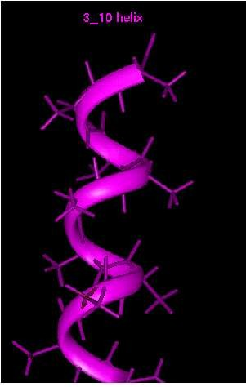
3₁₀ helix
A 3₁₀ helix is a type of secondary structure
found (often) in proteins and polypeptides
Top view of the same helix shown to the right
Three carbonyl groups are pointing upwards towards the viewer
spaced roughly 120° apart on the circle
corresponding to 3.0 amino-acid residues per turn of the helix

Slide 14
The Ramachandran Plot
Disallowed regions generally involve steric hindrance between the side chain C-beta methylene group and main chain atoms
Glycine has no side chain and therefore can adopt phi and psi angles in all four quadrants of the Ramachandran plot
Hence it frequently occurs in turn regions of proteins where any other residue would be sterically hindered

